Slide 1
CLIMATE CHANGE & SOCIAL CONFLICT: Understanding Conflicts & Societies to foster Peace in Asia
BY:
TAMUNOTONYE JOE OKORITE

Slide 2
TABLE OF CONTENT
Overview
Problem Statement
Dataset Description
Data Manipulation & Visualizations Steps
Observations
Summary
Question & Answer

Slide 3
OVERVIEW
Asia accounts for the majority of displacement due to natural disasters in the world. With over 14million people displaced in 2011 in this region alone with climate change as a major cause.

Slide 4
PROBLEM STATEMENT
How does climate change exacerbate social conflicts in Asia.

Slide 5
DATA SET DESCRIPTION
DATA NAME: Natural Disaster Record for Asia from
ABOUT: Records of all climatological disasters in Asia
PURPOSE: To understand social conflicts as a result of climate change in Asia
DATA SOURCE: EM-DAT, CRED / UCLO
SIZE: 141 Rows & 24 Columns
MISSING DATA: Data for some columns where not completely specified.

Slide 6
DATA MANIPULATION STEPS
Problem Definition
Data Collection
Data Cleaning
Data Exploration and analysis
Communicate finding (Visualization)

Slide 7
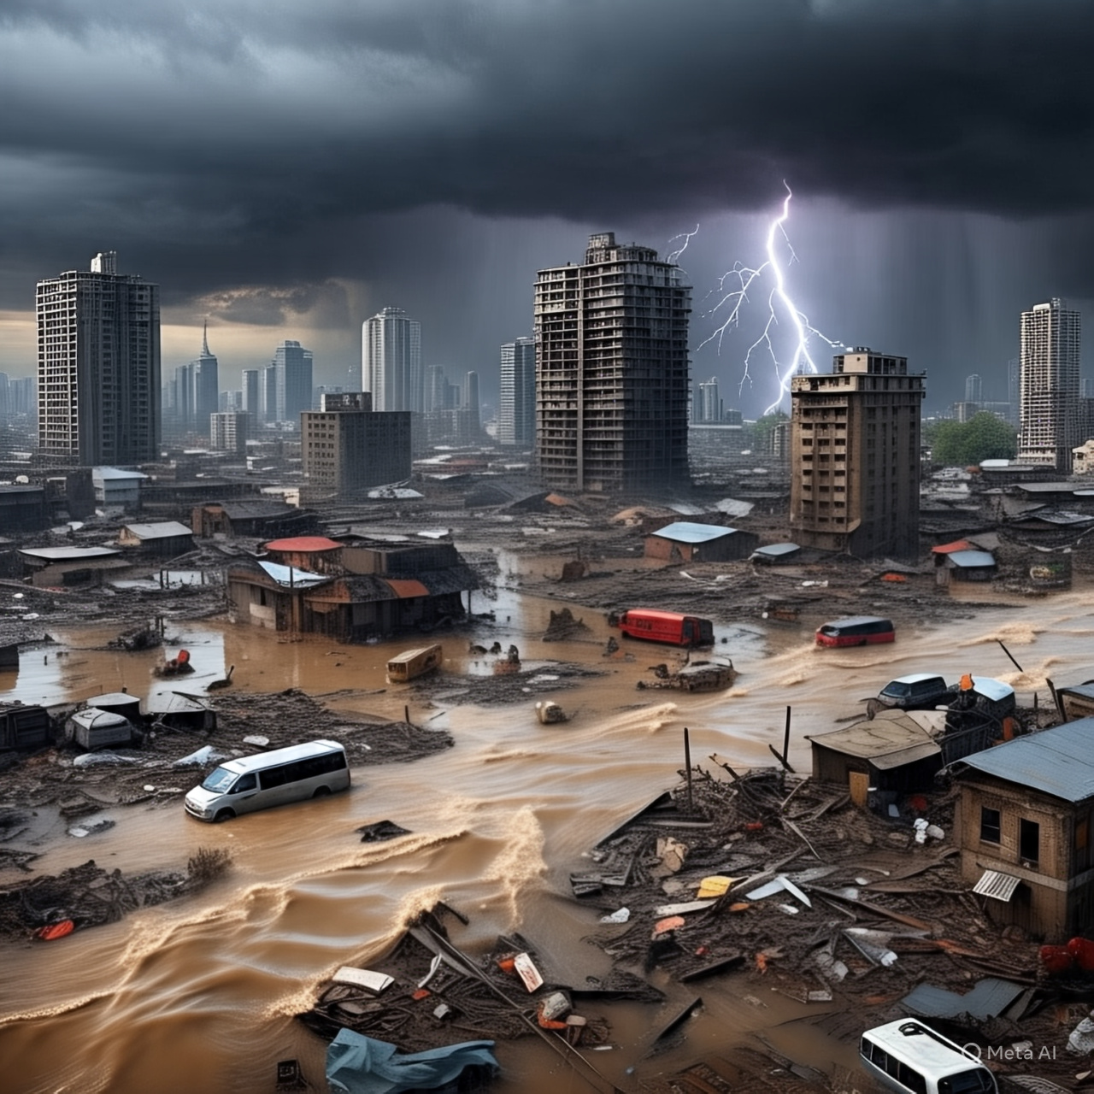
OBSERVATION

Slide 8
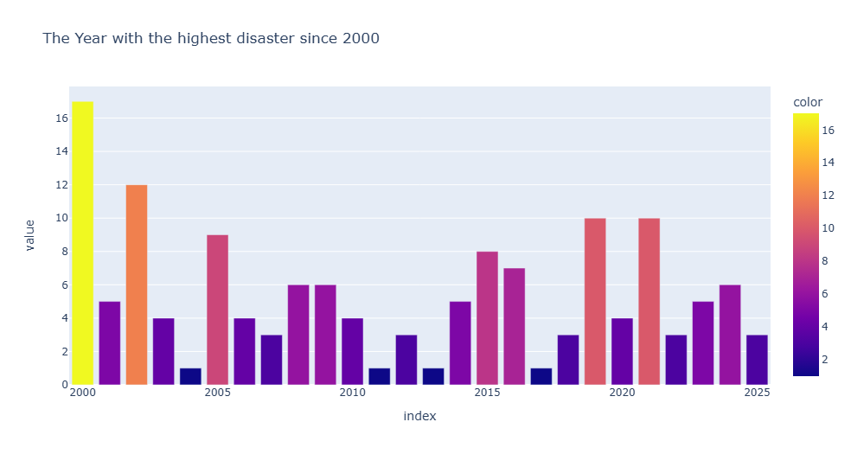

Slide 9
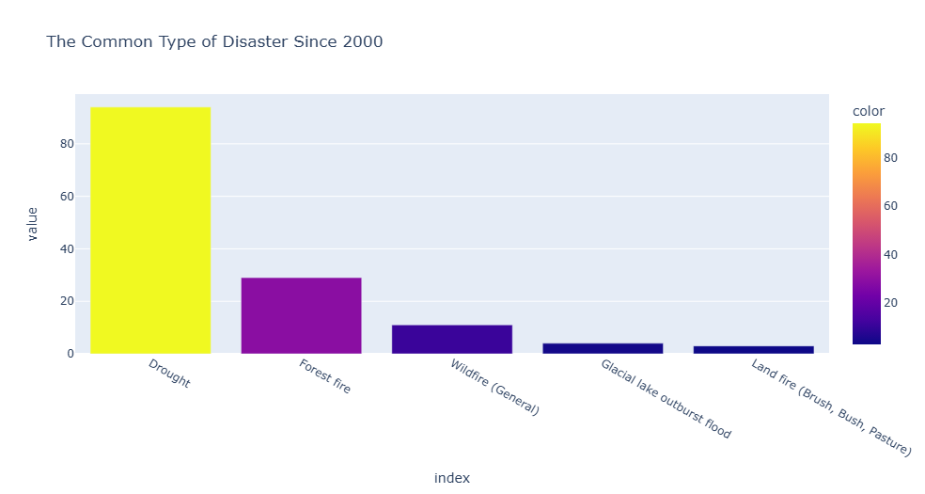

Slide 10
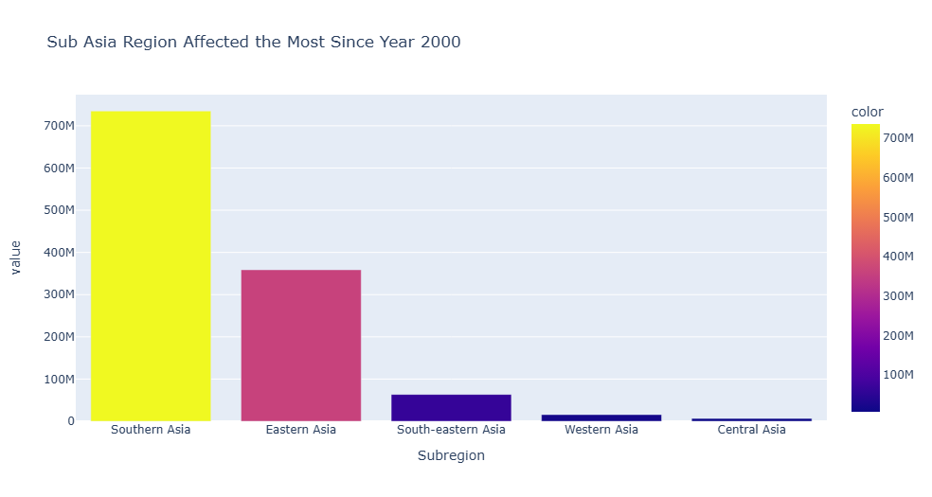

Slide 11
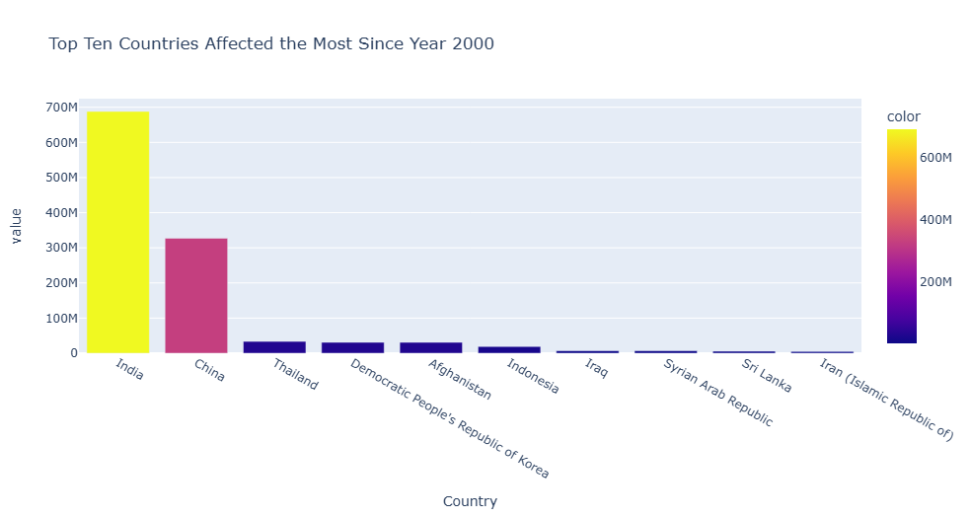

Slide 12
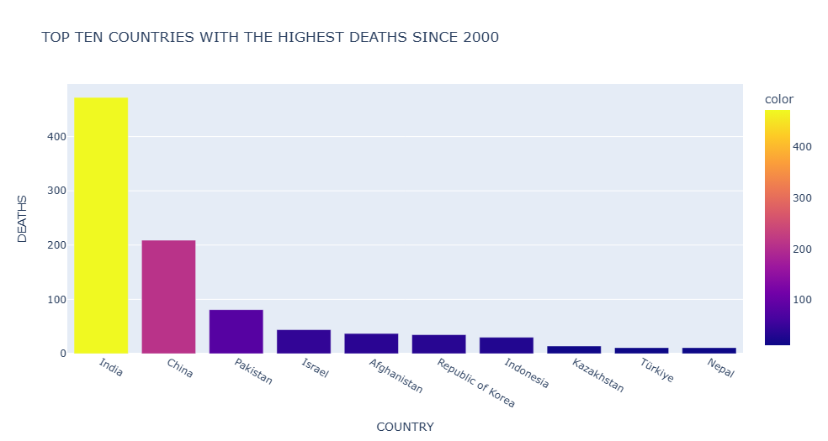

Slide 13
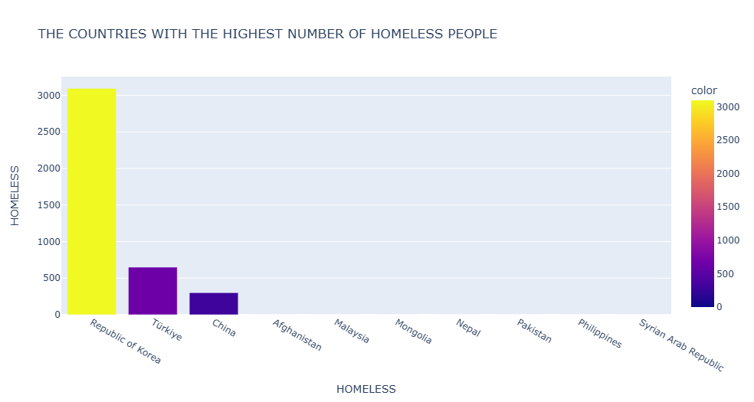

Slide 14
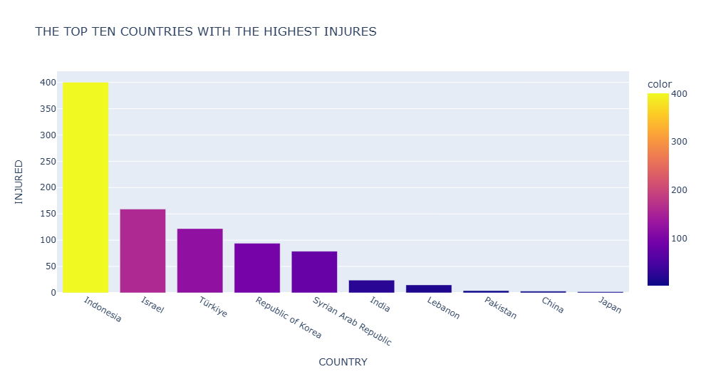

Slide 15
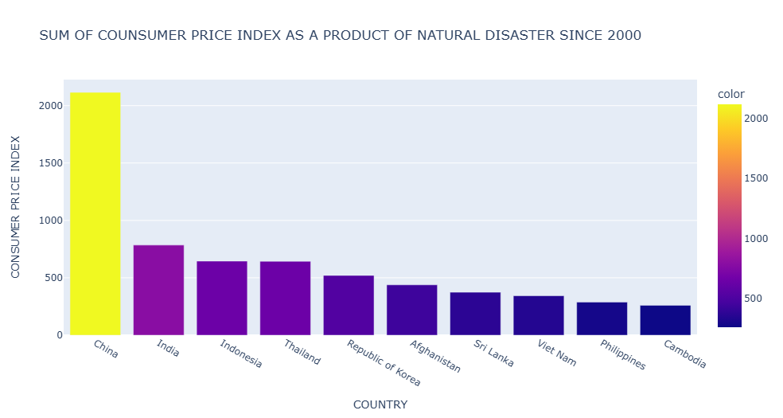

Slide 16
CONCLUSION
Southern Asia have been affected the most by climatologically disasters.
Natural disaster have been one of the major causes of homelessness in Asia.
Disaster caused by climate change e.g. drought have been on of the major factors responsible for the increase in Consumer Price Index (inflation)

Slide 17
QUESTION & ANSWER

